Slide 1
Information Security Portal
Jay Gandhi(201506100110138)
Project Guide : Mr. Hardik Vyas(Assistant Professor)

Slide 2
Project Definition
The system will provide facilities to Admin and Visitor user to manage the Information Security data and documents for the organization.

Slide 3
Software Requirement Specification

Slide 4
Purpose
The Purpose of this system is to reduce the work load and paper work of the Admin and its user. By using this system the Admin can save the time reduces cost and use this system any where.

Slide 5
Introduction
The Information security management system is the system to manage the important documents, policy, procedure, dashboard and logs in the organization. The system is specially made for the Admin (Information Security CTO). It is developed the maintain the logs, polices, procedure, dashboard, document library and help Admin of the organization to reduce paper work and can get reports of the events

Slide 6
System Users
Admin (Information Security CTO)
User

Slide 7
Functional Requirement
Admin (Information Security CTO)
The views of the admin side must be displayed role wise.
Admin can manage the dashboard.
Admin can manage the Information Security Awareness.
Admin can manage the document library.
Admin can manage the Logs.

Slide 8
Functional Requirement
Admin can manage the Policies.
Admin can manage the Procedure.
The document file of the policy and procedure should be automatically system generated update its content when the policy or procedure are renewed.
The system should have facilities to renew the policy and procedure in bulk.

Slide 9
Functional Requirement
The policy and procedure document should be updated automatically when the policy and procedure are approved.
The system should have facilities to approve the policy and procedure in bulk.
The notification must be generated if the policies or procedures are not approved.
The dashboard contain the basic blogs to view information.

Slide 10
Functional Requirement
User
Admin can manage the Logs.
Logs can be manage the role wise.
Mail must be triggered to notify for adding the monthly new log.
Once log is submitted after that new entry should not be attempt.

Slide 11
Functional Requirement
Reports should be generated by the system like
Total number of the records(category wise)
Total number of the records(Sub category wise)
Total number of policy with symbolic representation for validity
Total number of procedure with symbolic representation for validity
Total number of logs for current year (Bird Eye View)
All document must show in document viewer

Slide 12
Non-functional Requirement
Usability
This system provide good enough and proper GUI format with responsive and user friendly.
Security
In this system, login can be possible using windows authentication or using web references.

Slide 13
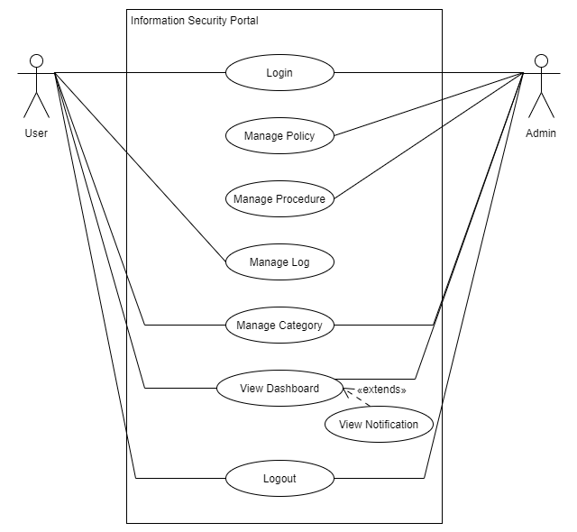
Usecase Diagram

Slide 14
Activity Diagram

